Slide 1
South Carolina Retirement System Solvency Analysis
Prepared by:Pension Integrity Project at Reason Foundation. 2022—Preliminary Draft

Slide 2
About the Pension Integrity Project
We offer pro-bono technical assistance to public officials to help them design and implement pension reforms that improve plan solvency and promote retirement security, including:
Customized analysis of pension system design, trends
Independent actuarial modeling of reform scenarios
Consultation and modeling around custom policy designs
Latest pension reform research and case studies
Peer-to-peer mentoring from state and local officials who have successfully enacted pension reforms
Assistance with stakeholder outreach, engagement and relationship management
Design and execution of public education programs and media campaigns

Slide 3
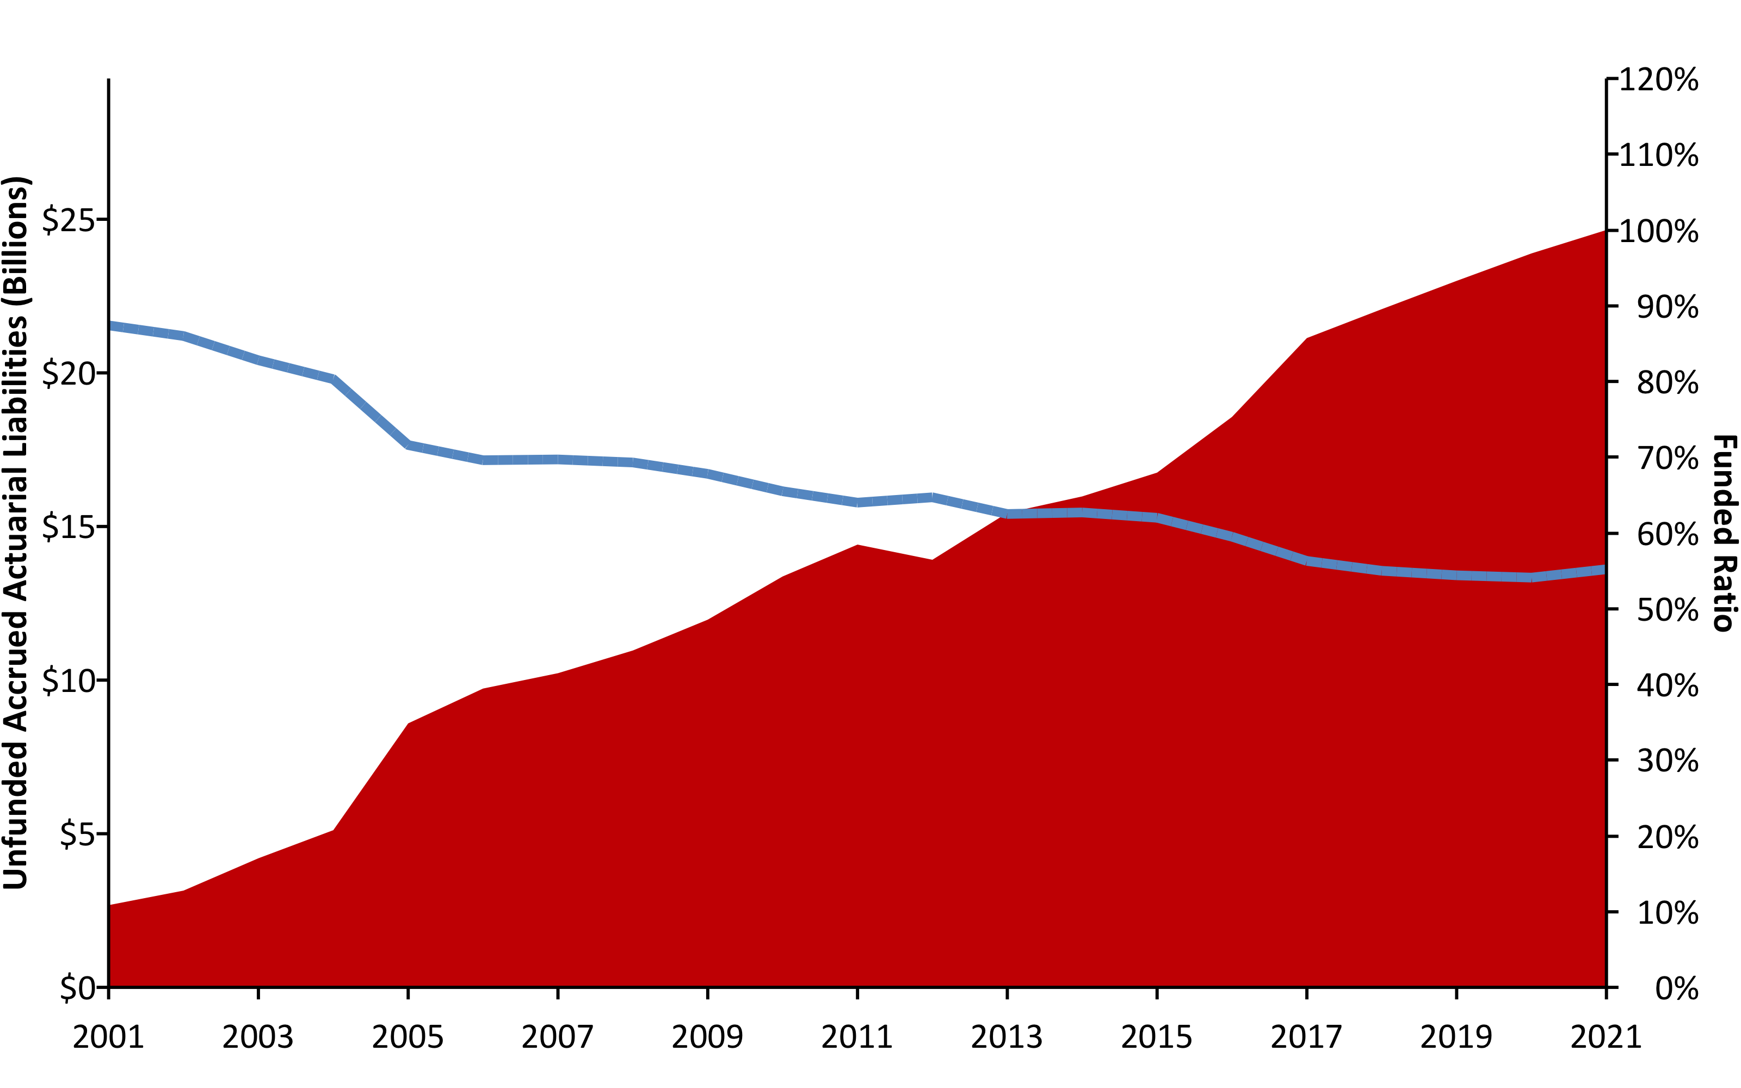
SCRS Unfunded Liabilities (2001-2021) w/ R (areaPlot())
Source: Pension Integrity Project analysis of SCRS actuarial valuation reports.

Slide 4
A History of Weakening Solvency #2 (2001/2021) w/ R (table)
 | UAL | Funded Ratio
2001 | $2,675,374,000 | 87.4%
2021 | $24,651,369,000 | 55.2%
Pension Integrity Project pension database.

Slide 5
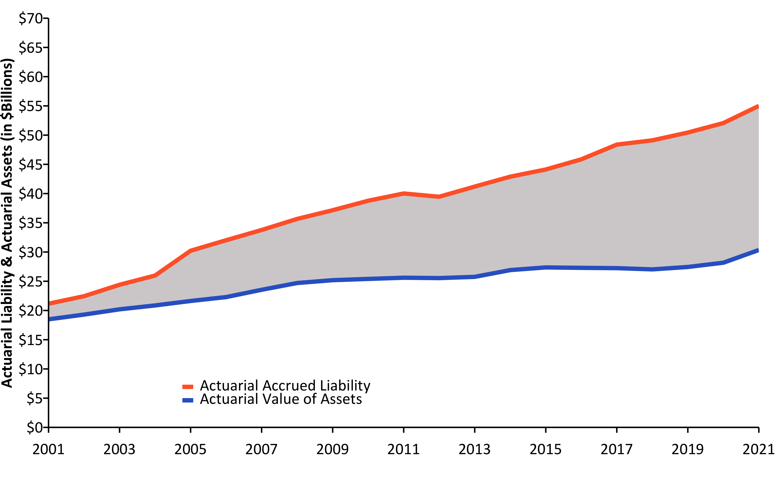
Liabilities Growing Faster than Assets (2001-2021) w/ R (linePlot())
Source: Pension Integrity Project analysis of SCRS actuarial valuation reports.

Slide 6
Causes of Pension Debt (2001-2021) w/ R (custom Plotly-Image)

Slide 7
Driving Factors Jeopardizing SCRS Resiliency
Deviations from Investment Return Assumptions have been the largest contributor to the unfunded liability growth, adding $9.82 billion from 2001 to 2021.
Changes to Actuarial Methods and Assumptions – including assumed rate of return - have revealed roughly $6.99 billion in additional unfunded liability since 2001.
Extended Amortization Timetables and low Statutory Contributions in the past have resulted in interest on SCRS debt exceeding the actual debt payments (negative amortization) since 2001, adding a net $3.68 billion to the unfunded liabilities.
Deviations from Demographic Assumptions – including deviations from assumed rates of withdrawal, retirement, and mortality — added $2.57 billion to the debt since 2001.
Ad-Hoc Cost-of-Living-Adjustments given before 2012 added $206 million to unfunded liabilities since 2001.

Slide 8
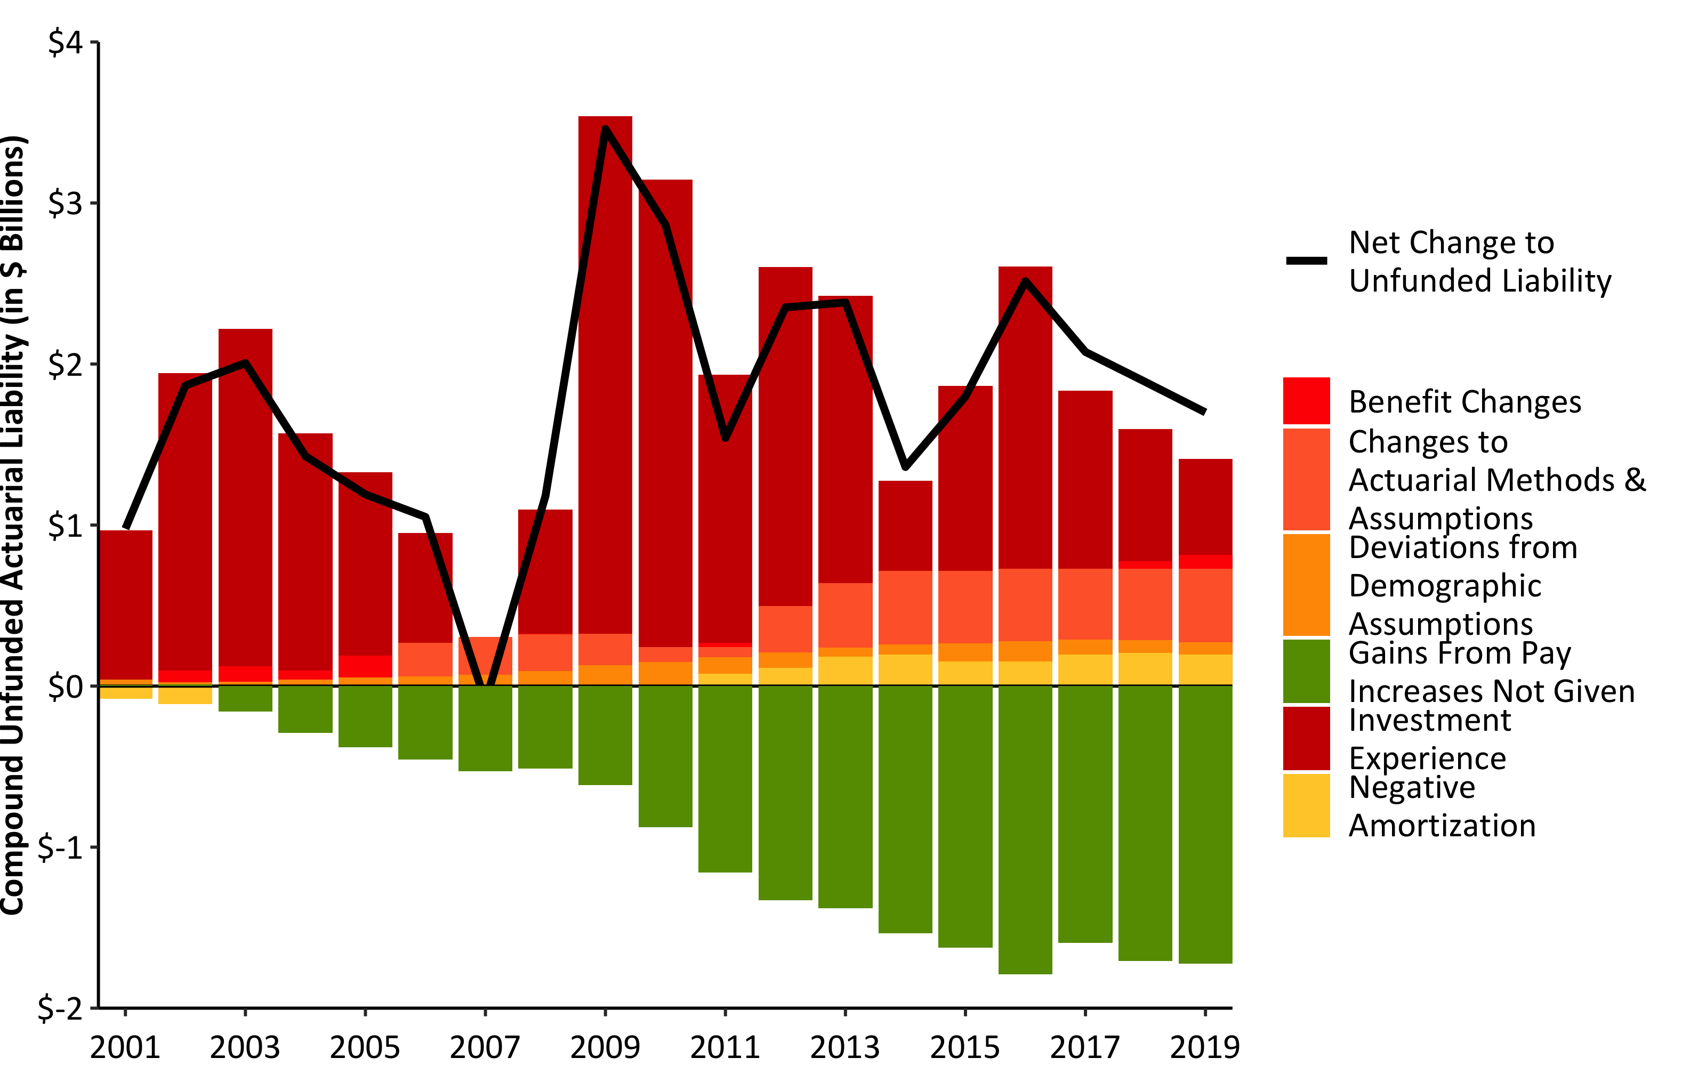
Compound Net Change to UAL w/ R (barPlot())
Source: Pension Integrity Project analysis of SCRS actuarial valuation reports.

Slide 9
Make up of Pension Contributions w/ R (flextable())
FY2023 Contributions | FY2023 Contributions | FY2023 Contributions
Contribution Type | % of Payroll | $ Value
Total Employee | 9.0% | $932,014,000
Total Employer | 17.6% | $1,742,976,450
Employer (Debt Amortization) | 15.6% | $1,549,422,687
Employer (Normal Cost) | 2.0% | $193,553,763
Total SCRS Contributions | 26.6% | $2,636,301,510

Slide 10
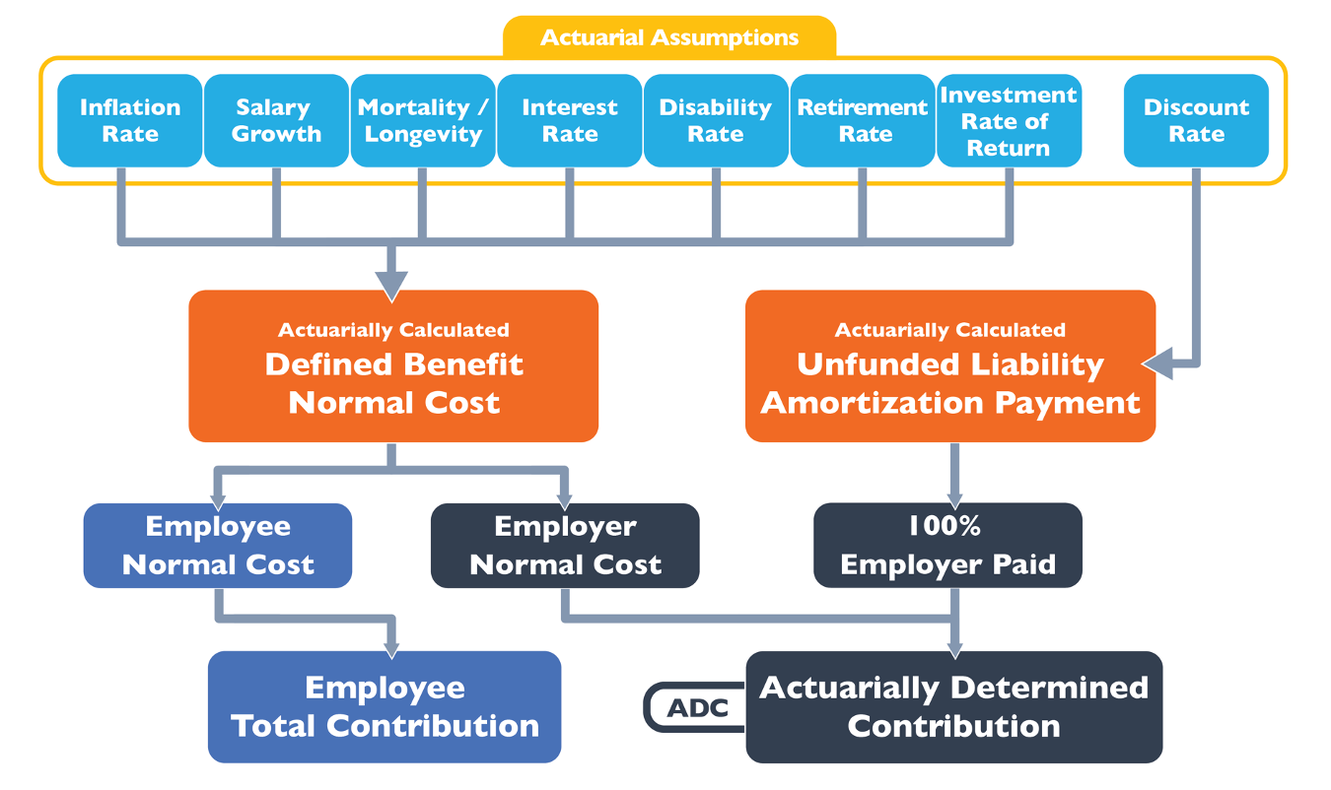
How a Pension Plan is Funded w/ Image

Slide 11
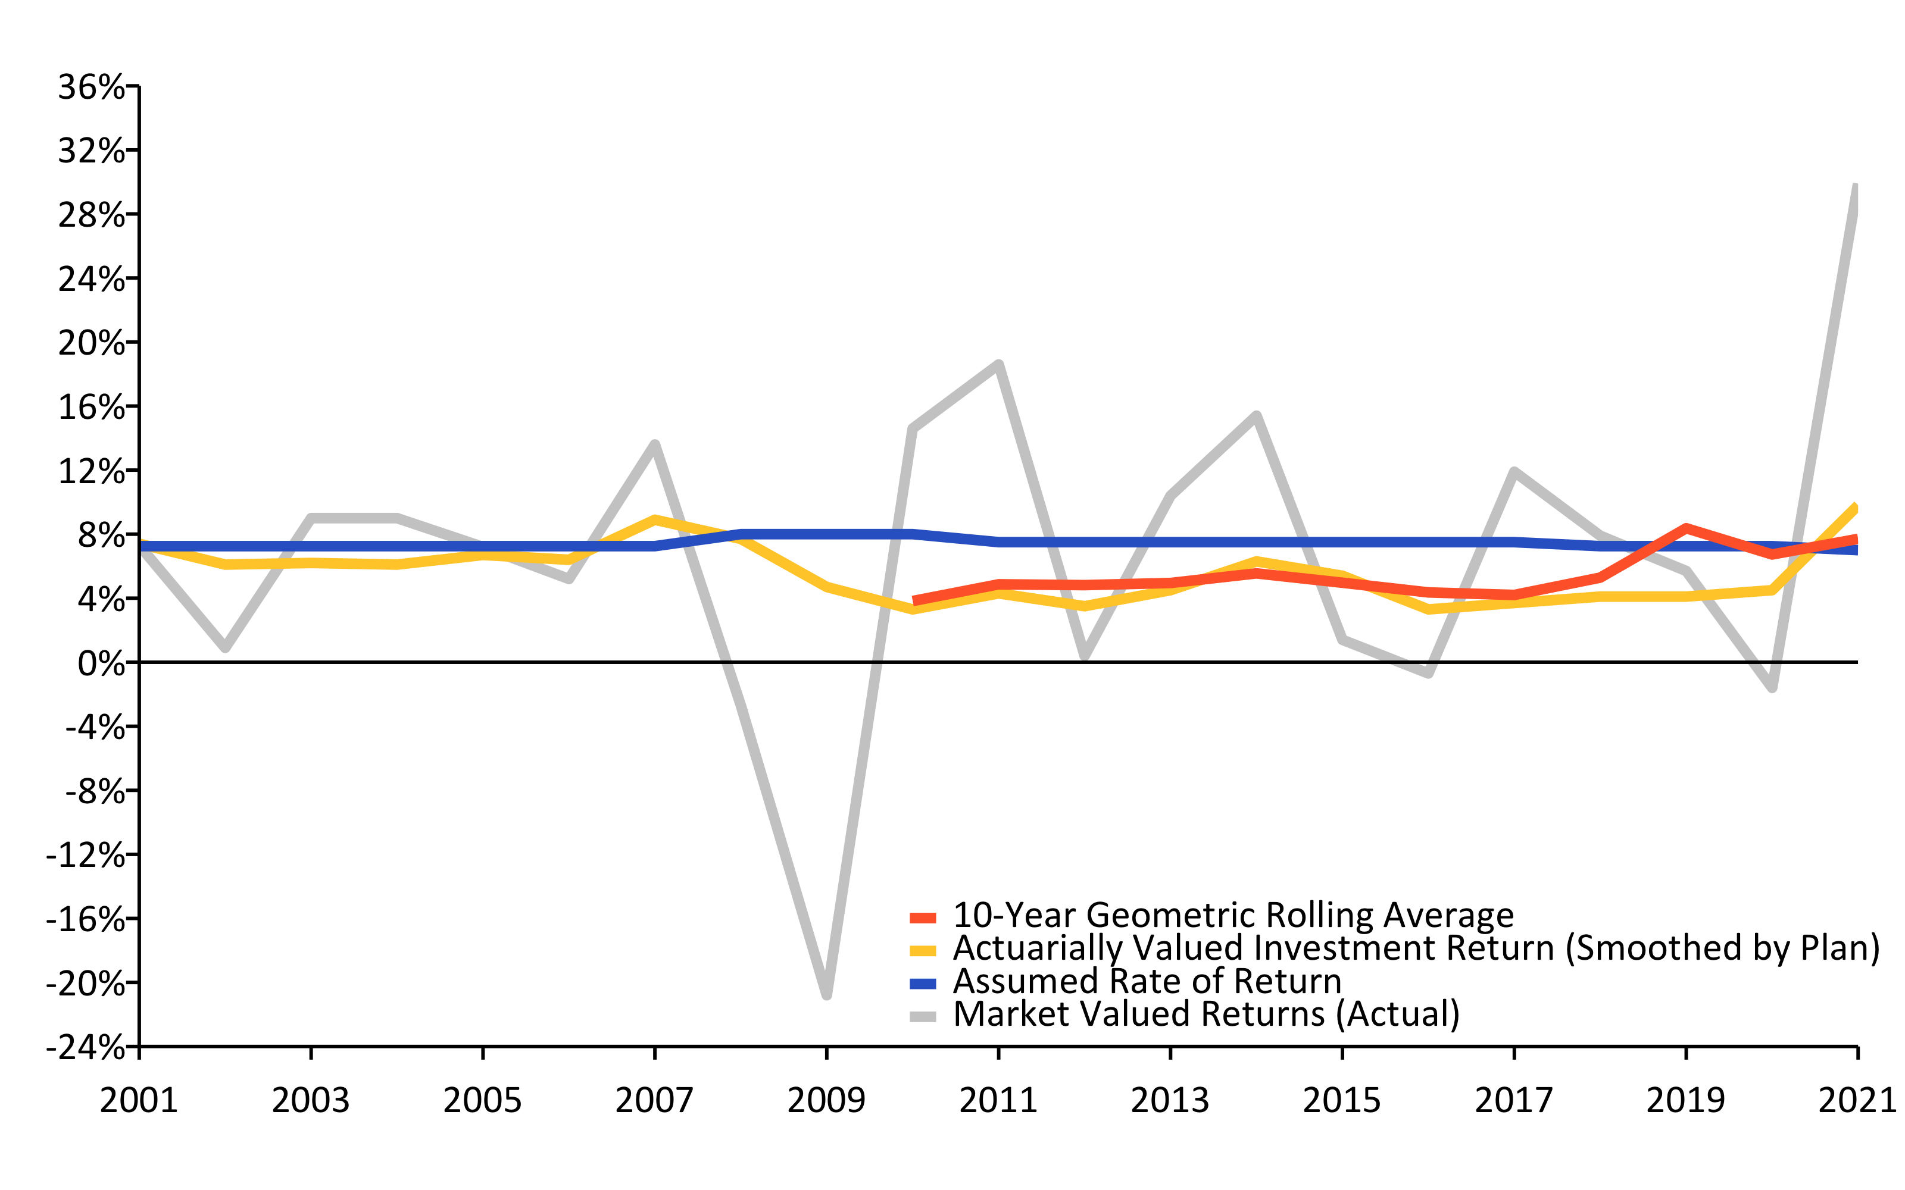
A History of Investment Returns (2001-2021) w/ R (linePlot())
Source: Pension Integrity Project analysis of SCRS actuarial valuation reports.

Slide 12
Investment Returns vs. Assumptions w/ R (flextable)
Year | Average Market Valued Returns | Average Actuarially Valued Returns
20-Years (2002-2021) | 6.3% | 5.50%
15-Years (2007-2021) | 6.3% | 5.20%
10-Years (2012-2021) | 7.7% | 4.90%
5-Years (2017-2021) | 10.3% | 5.20%

Slide 13
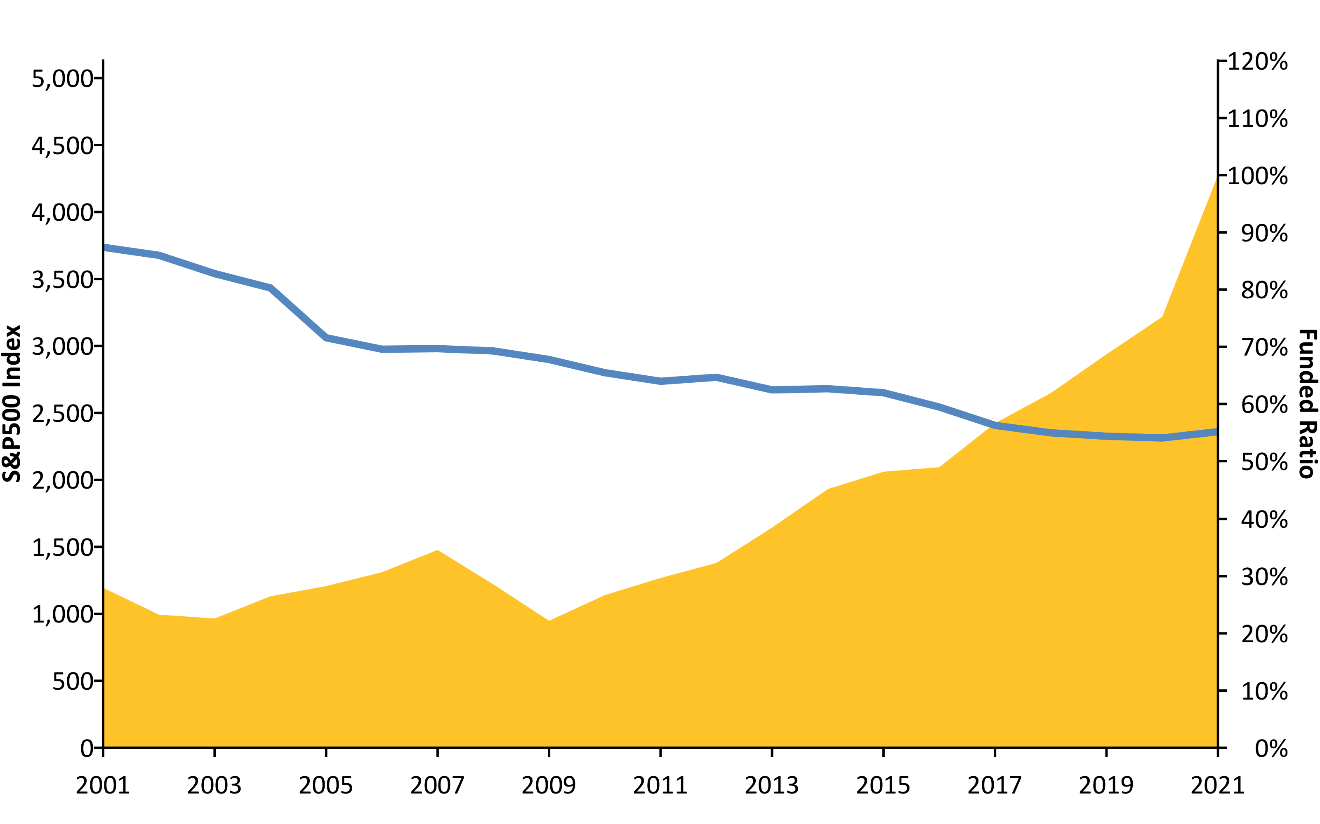
S&P500 vs. Funded Ratio (2001-2020) w/ R (areaPlot())
Source: Pension Integrity Project analysis of SCRS actuarial valuation reports.

Slide 14
New Normal: The Market Has Changed
The “new normal” for the institutional investing suggests that achieving even a 6% average rate of return is optimistic.
Over the past two decades there has been a steady change in the nature of the institutional investment returns.
30-year Treasury yields have fallen from around 8% in the 1990s to consistently less or around 3% today.
Globally, interest rates are at the ultralow historic levels, while market liquidity continues to be restrained by financial regulations.
McKinsey & Co. forecast the returns to equities will be 20% to 50% lower over the next two decades compared to the previous three decades.
Using their forecast, the best-case scenario for a 60/40 portfolio of equities and bonds is likely to earn less than a 5% return.
As FR waits for the “recover” its unfunded liabilities continue to grow.

Slide 15
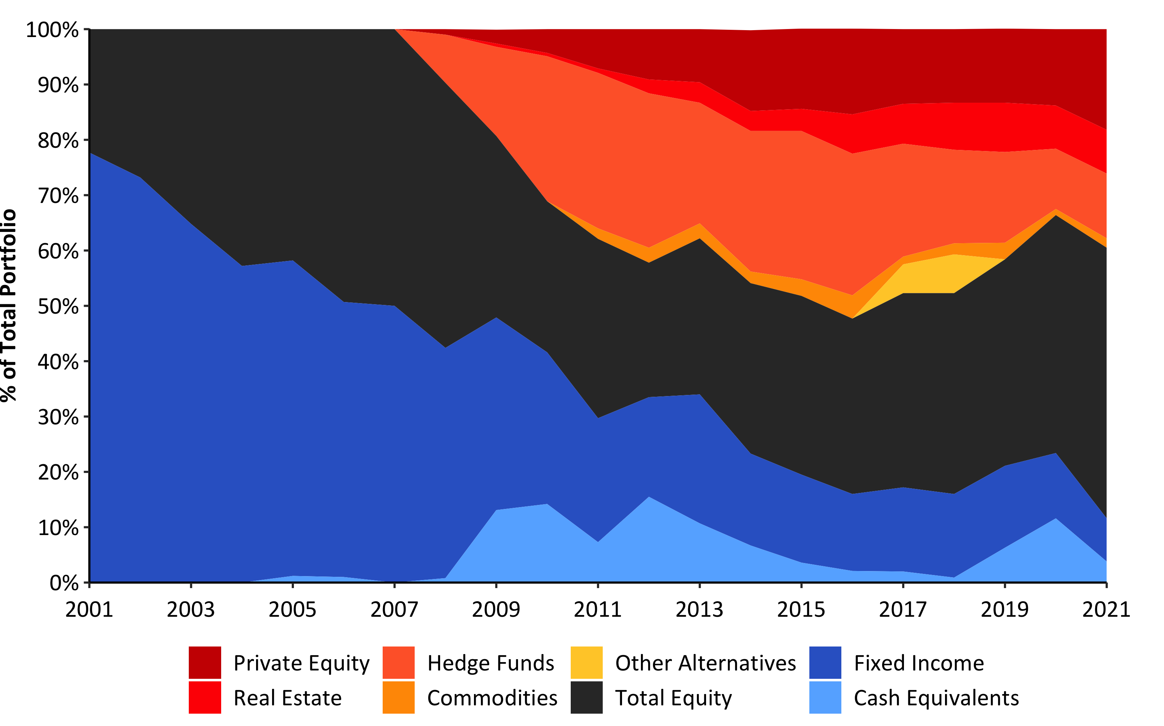
Asset Allocation (2001-2021) w/ R (custom)
Source: Pension Integrity Project analysis of SCRS actuarial valuation reports.

Slide 16
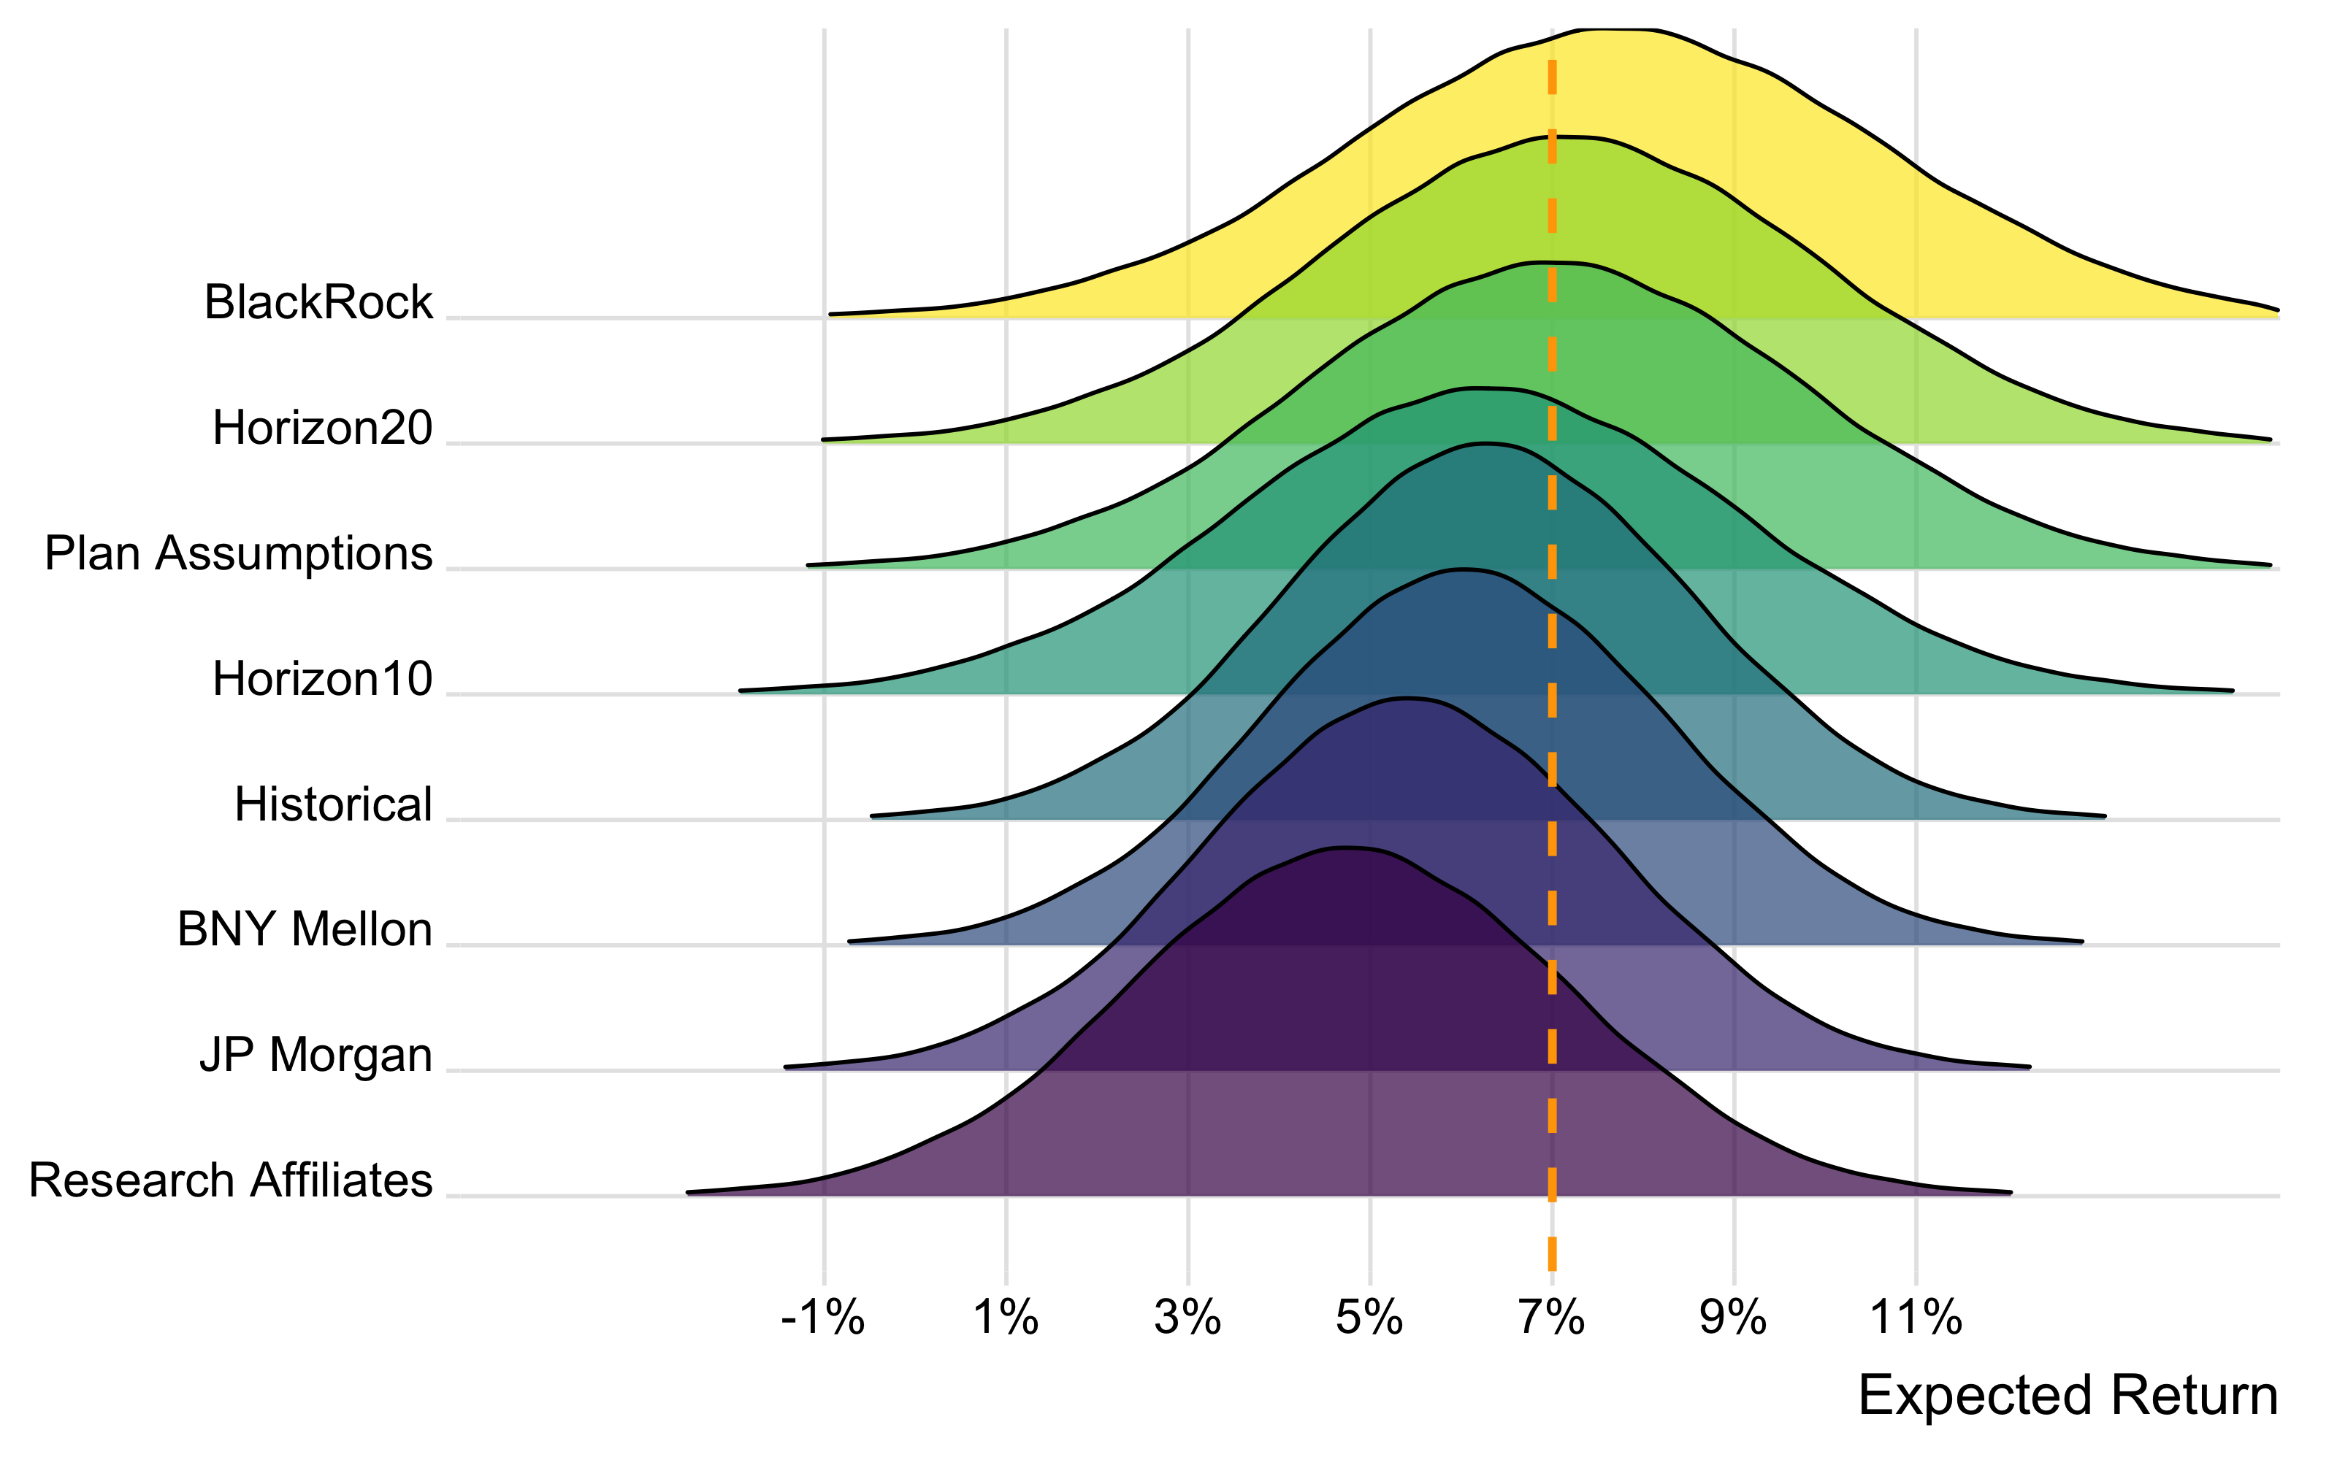
Probability Analysis w/ R (flextable())
Source: Pension Integrity Project Monte Carlo model based on SCRS asset allocation and reported expected returns by asset class. Forecasts of returns by asset class generally by BNYM, JPMC, BlackRock, Research Affiliates, and Horizon Actuarial Services were matched to the SCRS specific asset class. Probability estimates are approximate as they are based on the aggregated return by asset class. For complete methodology contact Reason Foundation.

Slide 17
Possible Rates of Return | Based on SCRS Assumptions | SCRS Historical Returns | Research Affiliates 10-Year Forecast | BNY Mellon 10-Year Forecast | Horizon 10-Year Market Forecast | JP Morgan 10-15 Year Forecast | Horizon 20-Year Market Forecast | BlackRock 20-Year Forecast
9 % | 23.3% | 11.1% | 3.8% | 5.5% | 9.2% | 16.0% | 25.1% | 32.8%
8 % | 35.8% | 22.0% | 8.9% | 12.5% | 18.9% | 26.4% | 38.0% | 45.9%
7 % | 50.1% | 37.3% | 17.6% | 24.1% | 33.3% | 39.6% | 52.4% | 59.7%
6.5 % | 57.5% | 46.1% | 23.5% | 31.6% | 41.8% | 46.8% | 59.7% | 66.2%
6 % | 64.5% | 55.1% | 30.4% | 39.8% | 50.7% | 54.1% | 66.6% | 72.3%
5.5 % | 71.1% | 63.8% | 37.9% | 48.6% | 59.7% | 61.3% | 73.0% | 77.7%
5 % | 77.0% | 71.9% | 46.1% | 57.5% | 68.2% | 68.2% | 78.7% | 82.6%

Slide 18
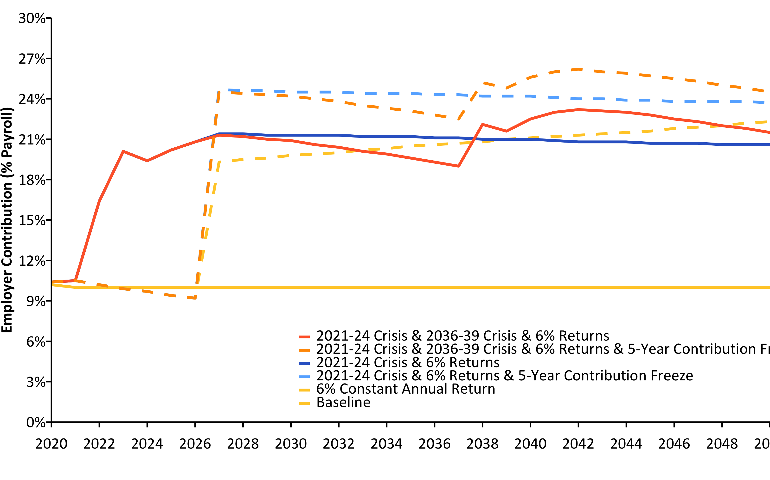
Current Contributions Are Actuarially Insufficient (2020-2050) w/ R (linePlot())
Source: Pension Integrity Project actuarial forecast of SCRS.

Slide 19
SCRS Unfunded Liability Sensitivity to DR Changes 2021 w/ R (flextable())
Discount Rate | Funded Ratio (MVA) | Unfunded Liability (MVA) | Actuarial Accrued Liability
7.0% | 60.9% | $21.50 | $55.00
6.0% | 46.5% | $38.60 | $72.00
5.0% | 36.5% | $58.30 | $91.80
4.0% | 29.5% | $80.20 | $113.70

Slide 20
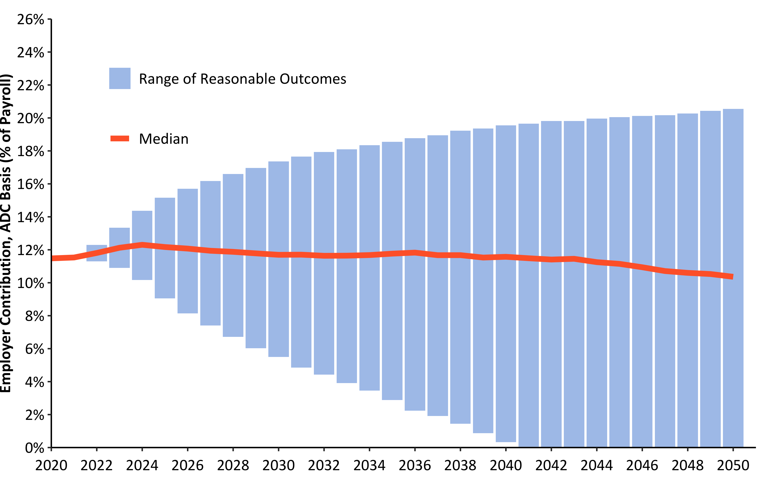
30-Year Employer Contribution Forecast w/ R (barPlot())
Source: Pension Integrity Project actuarial forecast of SCRS.

Slide 21
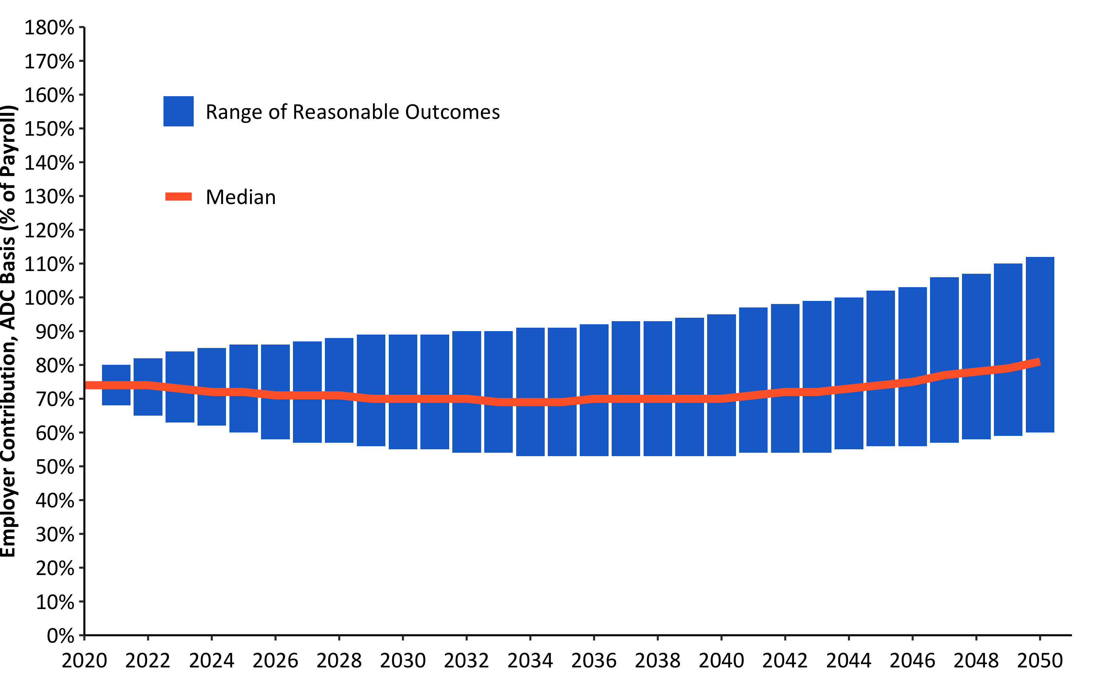
30-Year Funded Ratio Forecast w/ R (barPlot())
Source: Pension Integrity Project actuarial forecast of SCRS.

Slide 22
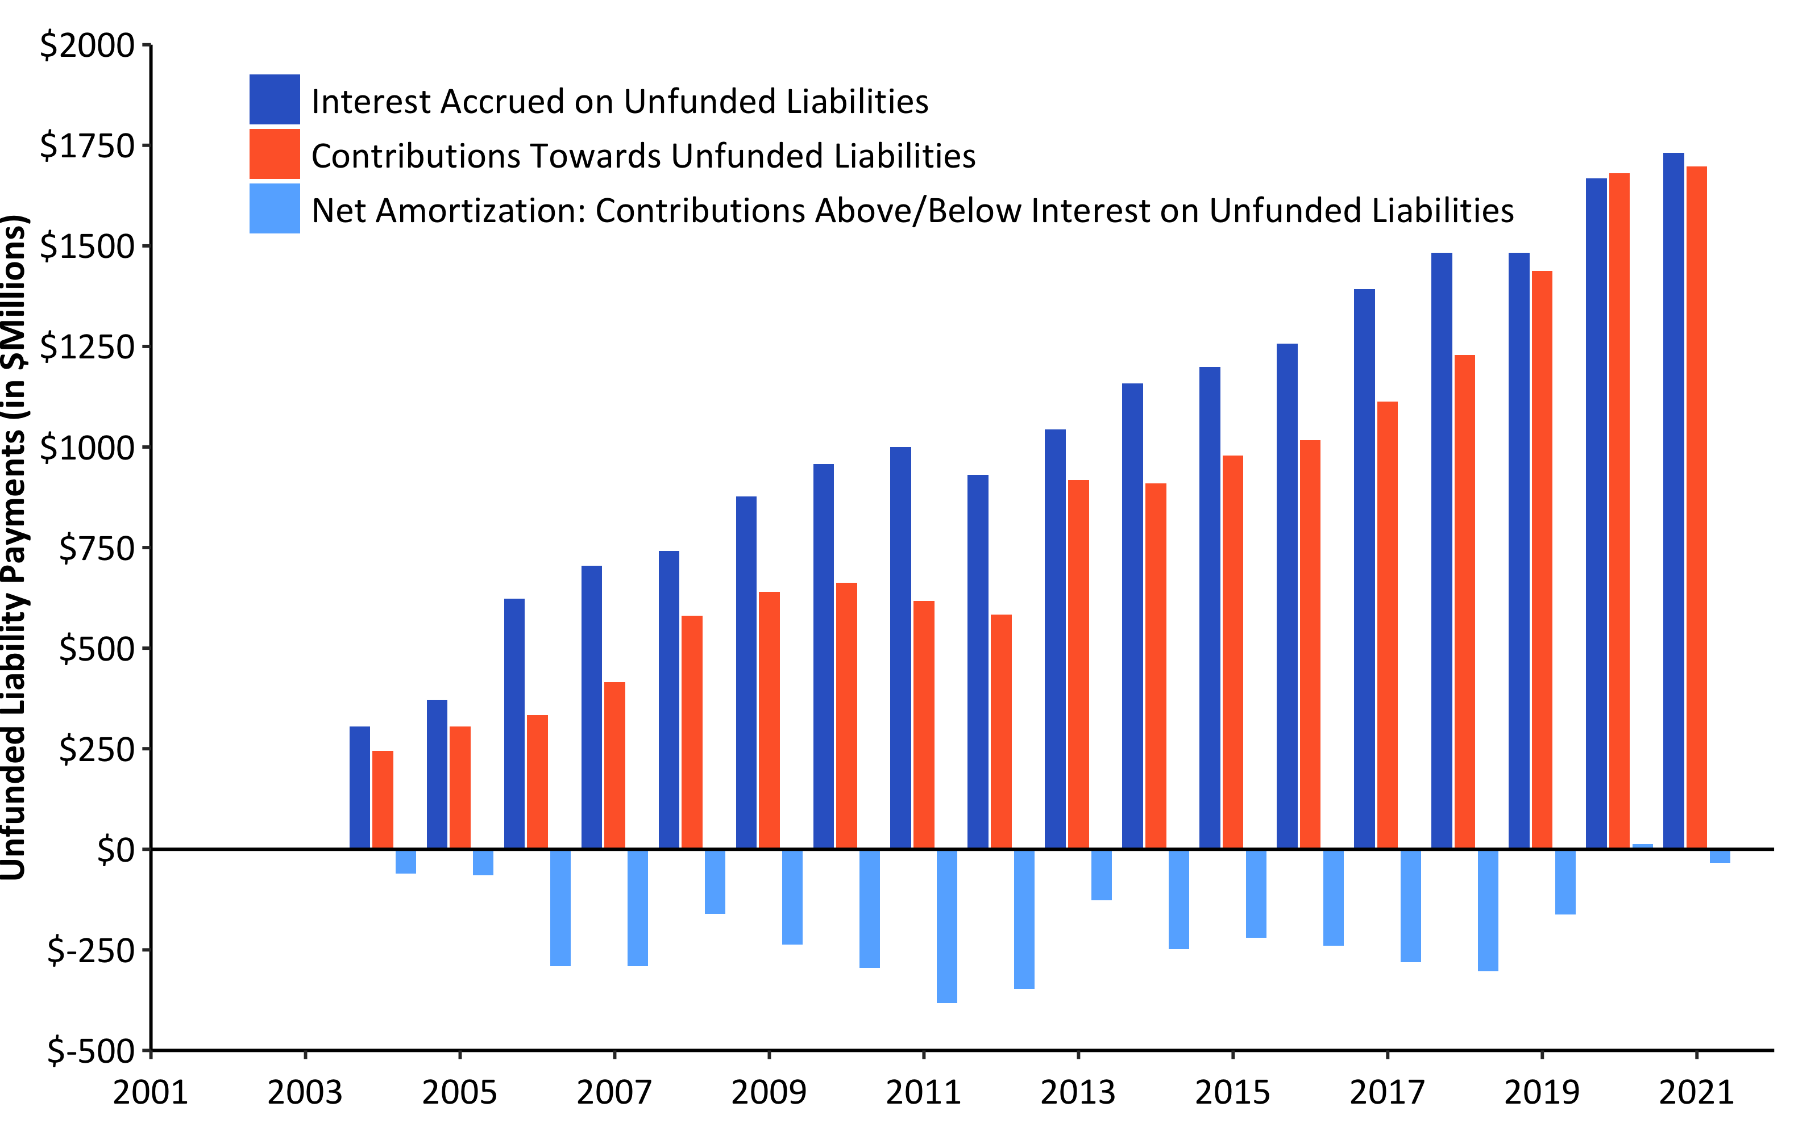
Debt Interest vs. Unfunded Liability Payments (2001-2021) w/ R (w/ barPlot())
Source: Pension Integrity Project analysis of SCRS actuarial valuation reports.

Slide 23
## [1] 3679.484

Slide 24
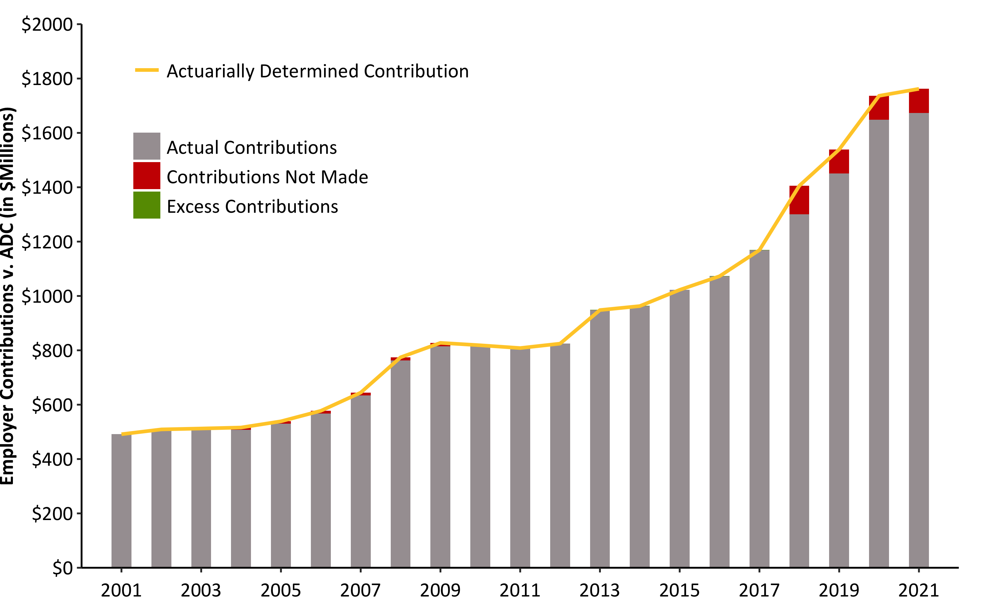
ADEC Contribution History (2001-2021) w/ R (barPlot())
Source: Pension Integrity Project analysis of SCRS actuarial valuation reports.

Slide 25
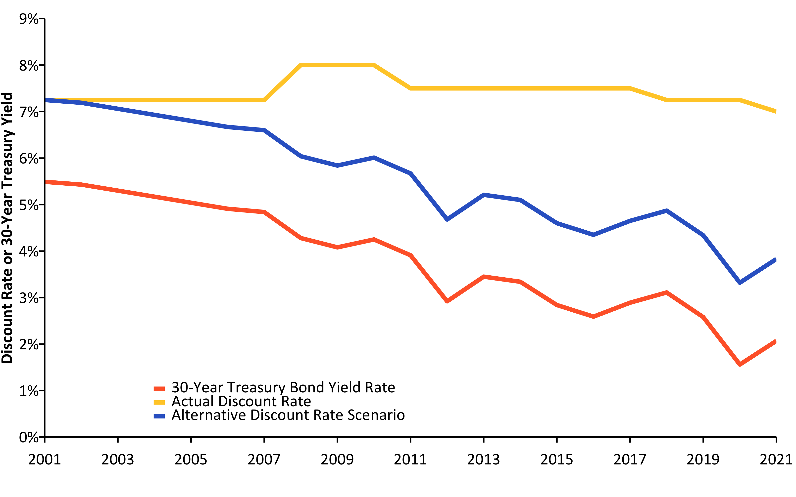
Change in Risk-Free Rate vs. Discount Rate (2001-2021) w/ R (linePlot())
Source: Pension Integrity Project analysis of SCRS actuarial valuation reports.

Slide 26
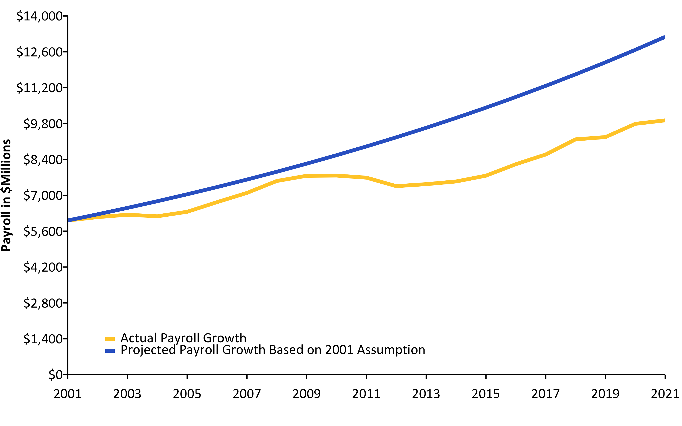
Actual Change in Payroll vs. Assumption (2001-2021) w/ R (linePlot())
Source: Pension Integrity Project analysis of SCRS actuarial valuation reports.

Slide 27
Actual Inflation vs. Assumption (2001-2020) w/ R (linePlot())
## Response [https://raw.githubusercontent.com/ReasonFoundation/databaseR/master/files/CPI_by_Region_DOL.xlsx] ## Date: 2022-01-03 13:48 ## Status: 200 ## Content-Type: application/octet-stream ## Size: 13.8 kB ## <ON DISK> /var/folders/0z/p5zgjmbn6531bgclzwc383500000gn/T//RtmpufpW2M/file6375fc38a32.xlsx

Slide 28
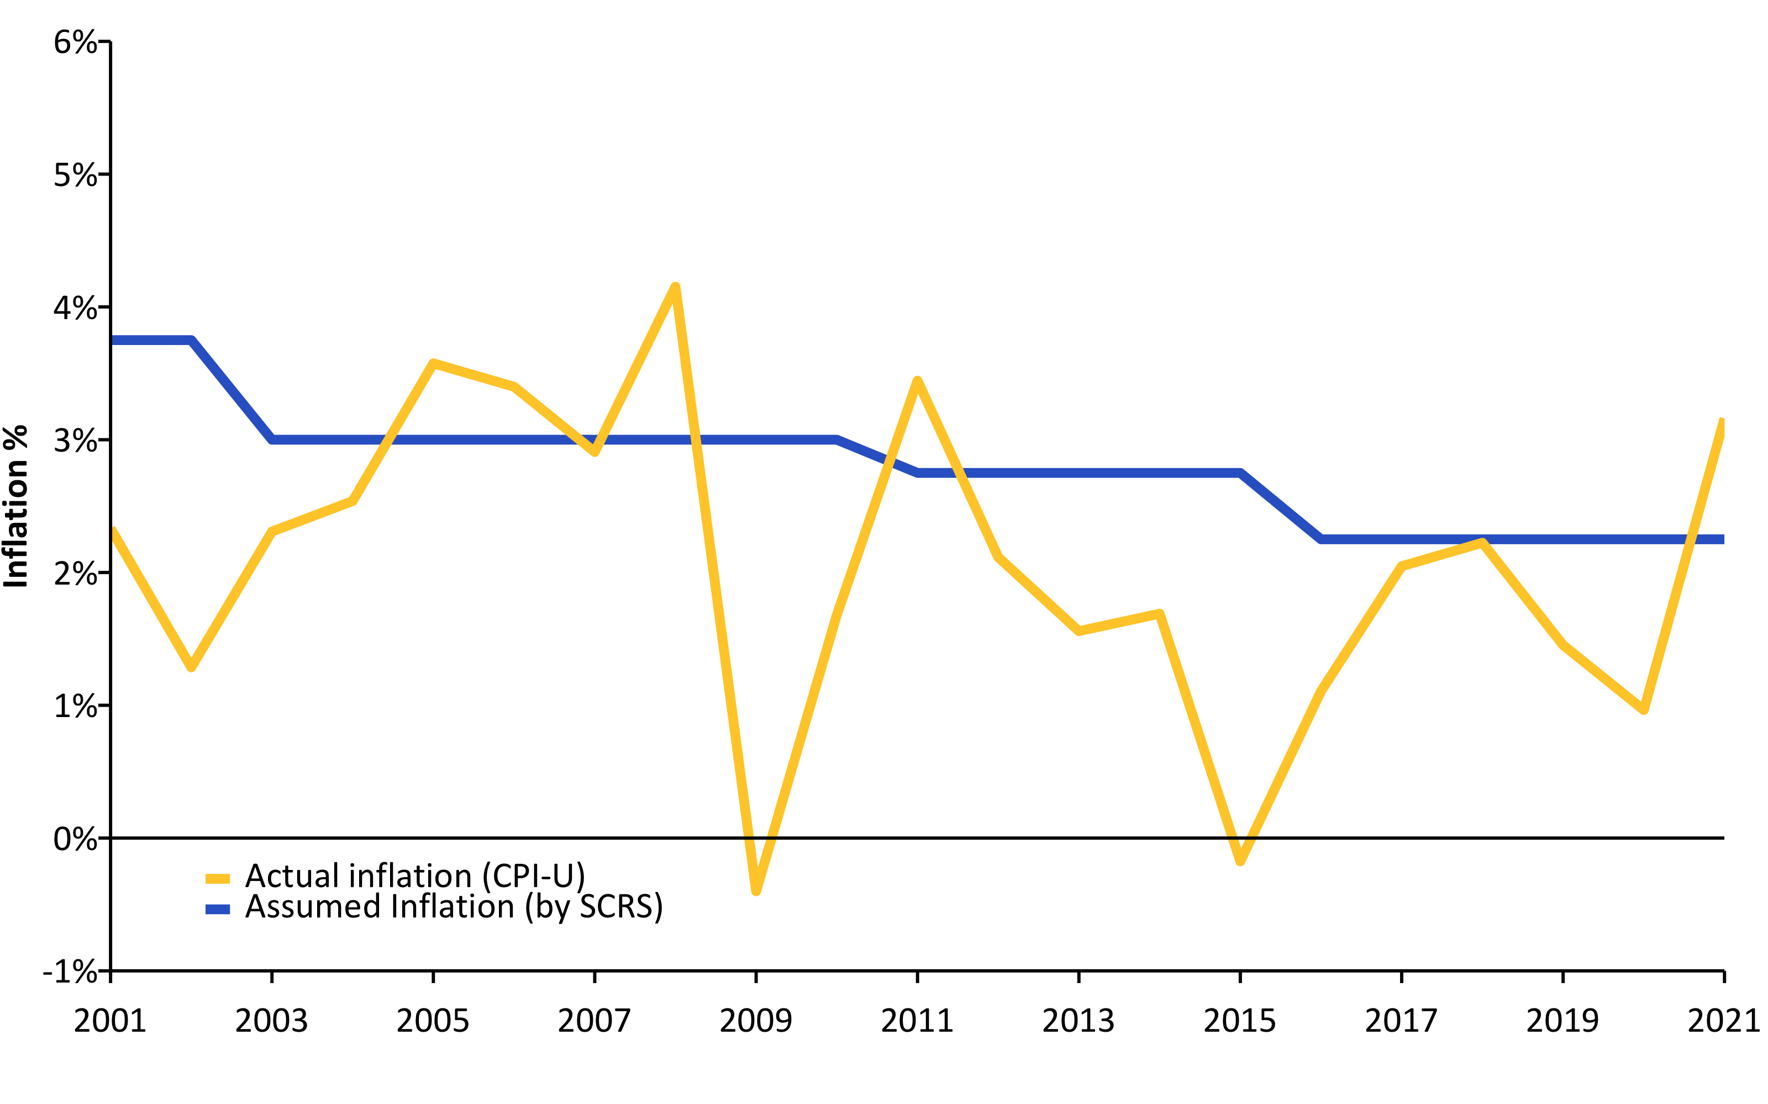
Source: Pension Integrity Project analysis of SCRS actuarial valuation reports.

Slide 29
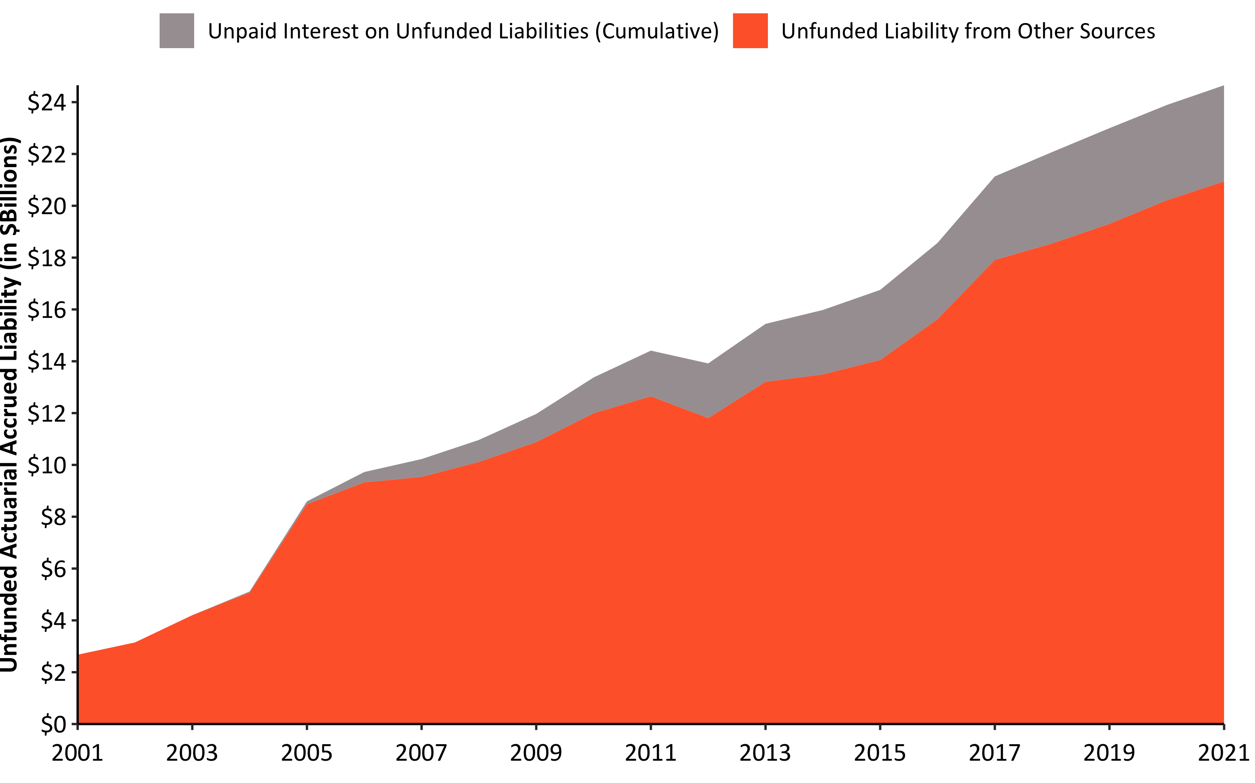
Interest on Debt 2001-2021 w/ R (custom)
Source: Pension Integrity Project analysis of SCRS actuarial valuation reports.

Slide 30
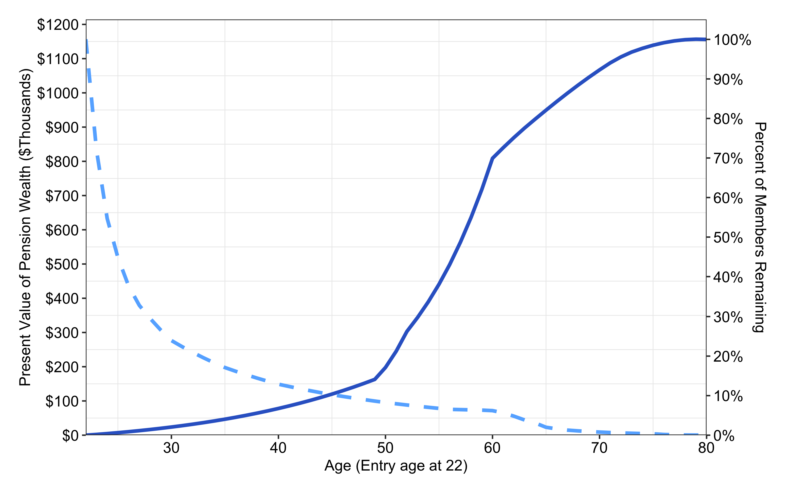
Benefit Accrual & Retention for New SCRS Employee w/ R (custom)
Source: Pension Integrity Project analysis of SCRS actuarial reports and CAFRs. Illustration is based on plan’s Tier 2, Tier 3, Tier 4 assumptions and a hypothetical analysis of an average member hired at the age of 25

Slide 31
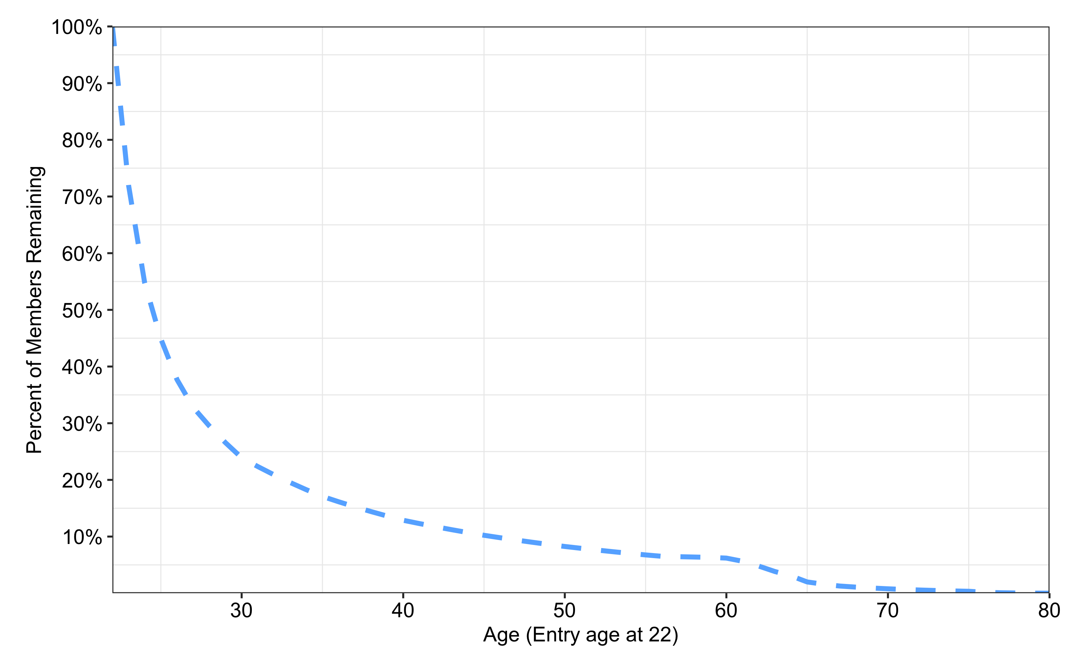
Retention Rates for a New SCRS Employee w/ R (custom)
Source: Pension Integrity Project analysis of SCRS actuarial reports and CAFRs. Illustration is based on plan’s Tier 2, Tier 3, Tier 4 assumptions and a hypothetical analysis of an average member hired at the age of 25

Slide 32
Retention: Only Few of 22 Age New SCRS Hires Receive Benefits
Only 26.6% of new SCRS employees will stay for 8 years to vest.
Only 12.3% of the same employees will be on the job after 20 years.
And only 6.5% of the same employees will be on the job after 36 years needed to qualify for full retirement (YOS + AGE = 90)

Slide 33
References
https://github.com/ReasonFoundation/GraphicsR
https://rstudio.com/wp-content/uploads/2015/03/rmarkdown-reference.pdf
https://bookdown.org/yihui/rmarkdown/

